Slide 1

EBU FORECAST
23-24 November 2016
Spectrum for 5G
Eric Fournier
Chairman, Electronic Communications Committee

Slide 2
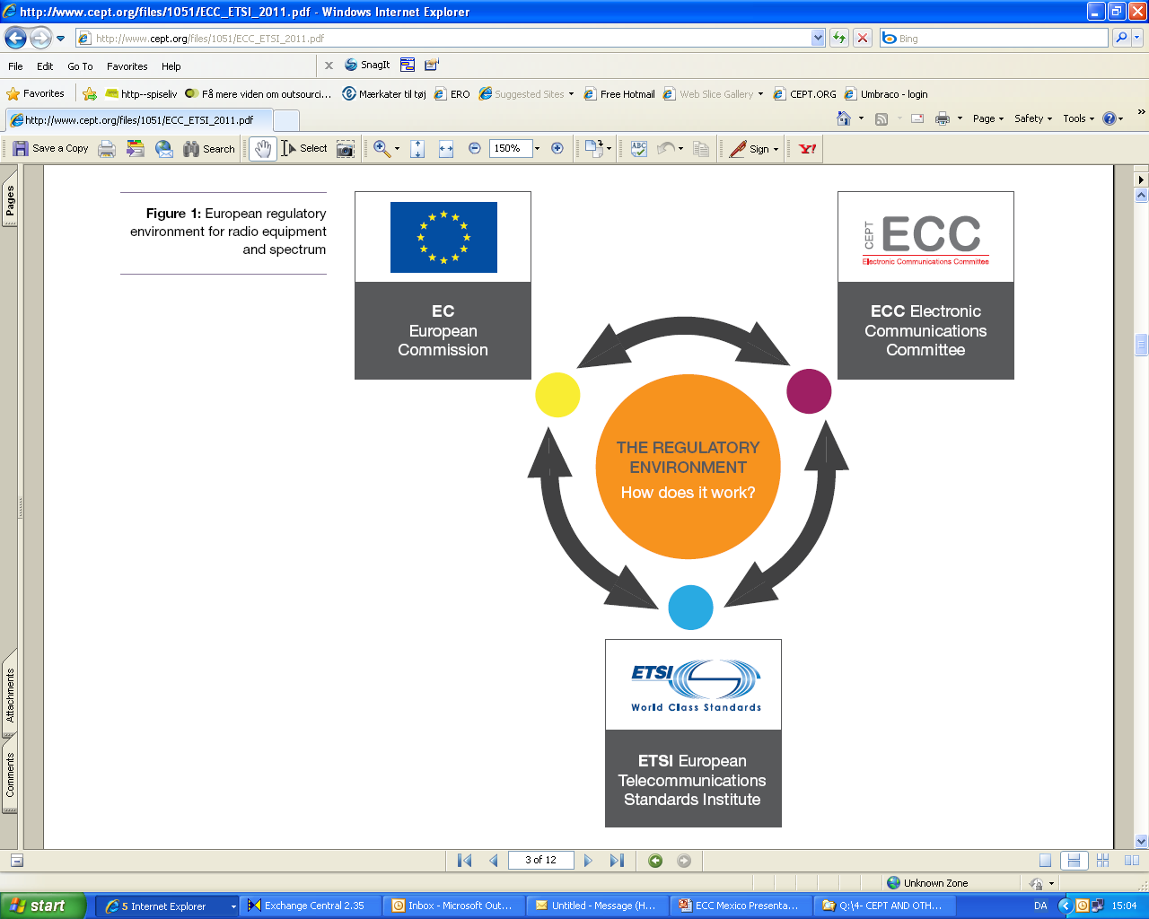
European spectrum policy and harmonisation
EC Mandates
Spectrum regulation
ECC Decisions
ECC Recommendation
ECC Reports
EC Decisions
CEPT Reports
RADIO SPECTRUM POLICY GROUP (RSPG)
Opinion
Report
ETSI SRDoc
Placing equipment on the market
Harmonised Standards

Slide 3
RSPG opinion on 5G
Member States making recommendations
to the EC
3.4-3.8 GHz as
the primary band suitable for 5G
5G also needs bands
below 1 GHz (e.g. 700 MHz)
nationwide and indoor coverage
A need to ensure that technical and regulatory conditions for all bands already harmonised are fit for 5G
26 GHz “pioneer” band above 24 GHz
Following considerations in PC of 3 possible bands : 26 GHz, 32 GHz and 42 GHz

Slide 4
5G CEPT Roadmap
New CEPT Roadmap for 5G following CEPT workshop:
Ensuring that harmonised technical conditions fit 5G
    3.4-3.8 GHz
    26 GHz harmonisation decision before WRC-19
    Other bands – 4G+ as providing 5G services ? 5G mode for paired bands ?
  WRC-19 preparations
  How to respond to needs for verticals?
  Backhauling, role of satellite, licensing …
http://cept.org/Documents/ecc/33486/ecc-16-110-annex-17_cept-roadmap-for-5g

Slide 5







What 5G can bring to verticals ?
            Various vertical sectors potentially addressed by 5G
Automotive
Railways
Media
Utilities
Public safety
Industrial automation
Home automation
            and many more…

Slide 6
Network slicing to adapt to verticals requirement
            High reliability: 99.99% (e.g. automation) – 100 % (e.g. public safety, transportation)
            Very low latency: < 10 ms (e.g. automotive, content production, public safety)
            Seamless coverage: territory (e.g. utilities) & population (e.g. public safety, media)
            High QoS
            Long life time and availability of spare parts: up to 20 years (e.g. automotive, railways, utilities, automation)
            High degree of security

Slide 7
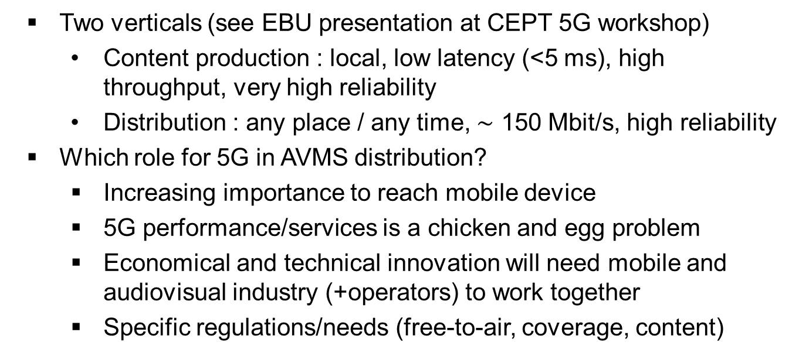
Audiovisual sector as “vertical”
            Two verticals (see EBU presentation at CEPT 5G workshop)
              Content production : local, low latency (<5 ms), high throughput, very high reliability
              Distribution : any place / any time, $\sim$ 150 Mbit/s, high reliability
            Which role for 5G in AVMS distribution?
              Increasing importance to reach mobile device
              5G performance/services is a chicken and egg problem
              Economical and technical innovation will need mobile and audiovisual industry (+operators) to work together
              Specific regulations/needs (free-to-air, coverage, content)

Slide 8




Spectrum for 5G above 24 GHz
24.25-27.5 GHz
31.8-33.4 GHz
37-43.5 GHz
45.5-50.2&50.4-52.6 GHz
66-76&81-86 GHz
?
WRC 15
AI 1.13 WRC 19
WRC 19
ECC/CPG prepare
positions for WRC 19
Which Frequency band(s)
for 5G in Europe?
RSPG opinion
on 5G
A pioneer band above 24 GHz harmonised < 2020
Other bands > WRC-19
5G Mandate
CEPT Report

Slide 9
Challenges for 5G studies
Compatibility
with other services
Knowledge of systems characteristics parameters
5G systems MIMO Antennas modelling
Timeframe for ITU and CEPT studies

Slide 10
Supplemental Downlink (SDL) in Europe
1452-1492 MHz already harmonised in Europe for SDL
SDL also as preferred solution in the band 1427-1452 MHz and 1492-1518 MHz
    Channelling arrangement and harmonisation by end 2017
Four blocks of 5 MHz SDL in the 700 MHz under national option

Slide 11
UHF TV band
  WRC-23 agenda item
  2.5 to review the spectrum use and spectrum needs of existing services in the frequency band 470-960 MHz in Region 1 and consider possible regulatory actions in the frequency band 470-694 MHz in Region 1 on the basis of the review in accordance with Resolution 235
  Preparation will start only after WRC-19
  ECC Report 224 on “long term vision for the UHF broadcasting band”
    Which experience of “flexibility”?
    Increasing need of AVMS on mobile terminals

Slide 12




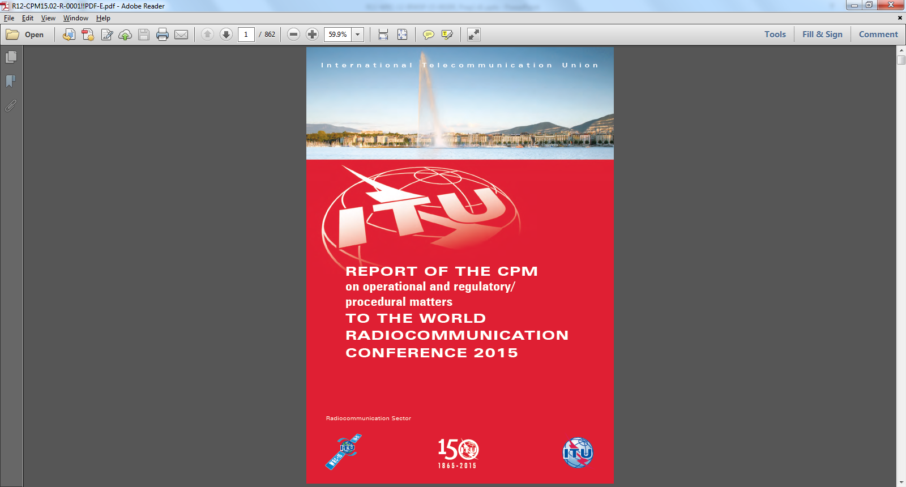

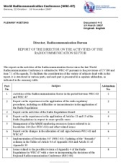

WRC-19 Process
APT
Coordinated
Proposals
Proposals
ASMG
Informal
Group
(Structure
&
Chairmanship)
Member States
ATU
WRC-19
160 Member States
3400 Participants
CEPT
CPM Report
Conference
Secretariat
(BR & GS)
Agenda:
Draft WRC Res &
Final Council Decison
Director’s Report
RA-19
RCC

Slide 13
Thanks ...

